Slide 1
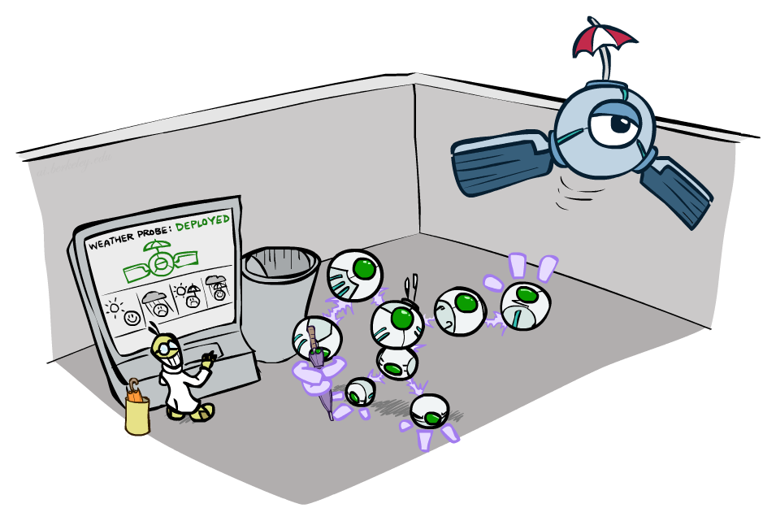
Artificial Intelligence
Decision Networks and Value of Perfect Information
[These slides were created by Dan Klein, Pieter Abbeel, and Anca. http://ai.berkeley.edu.]
Notes:
Please retain proper attribution, including the reference to ai.berkeley.edu. Thanks!
‹#›

Slide 2
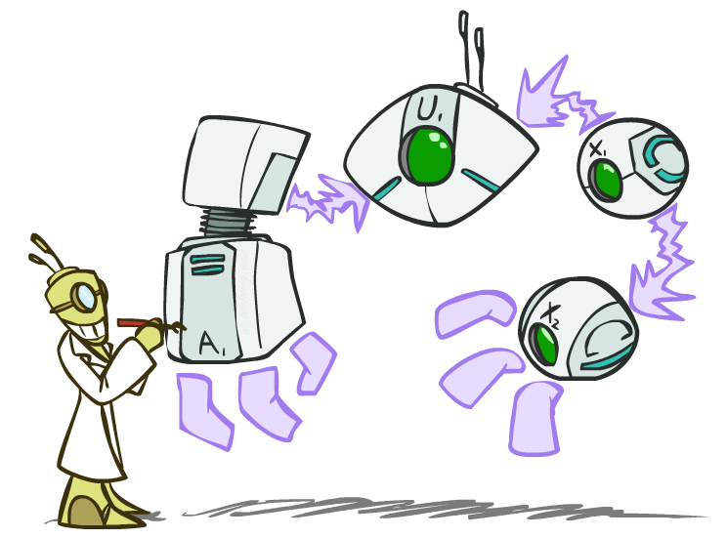
Decision Networks

Slide 3

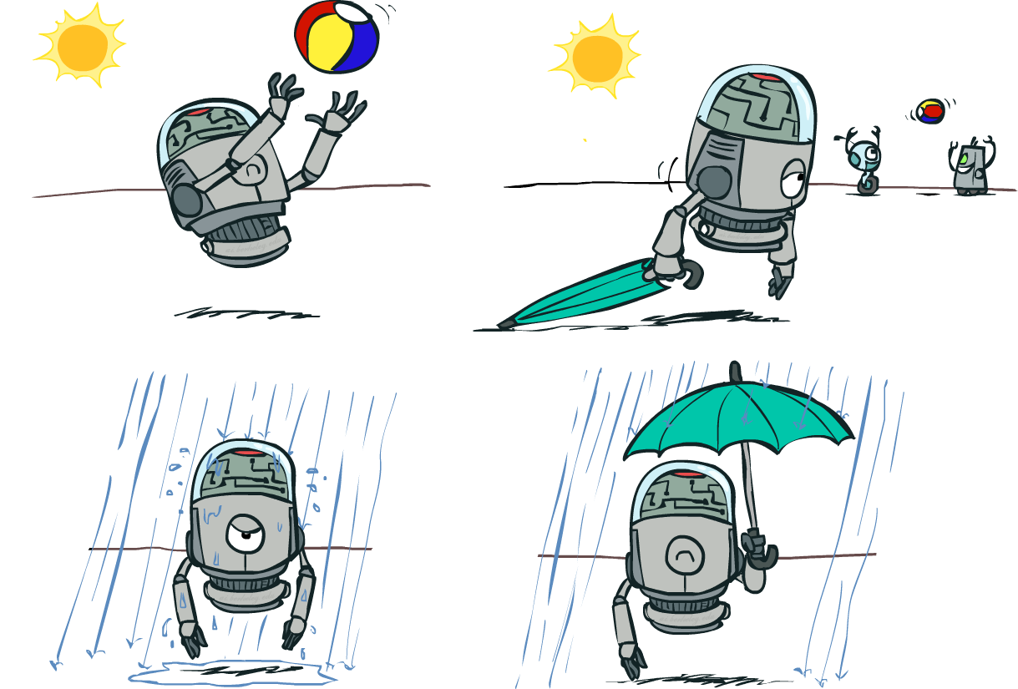
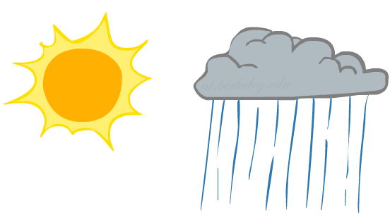
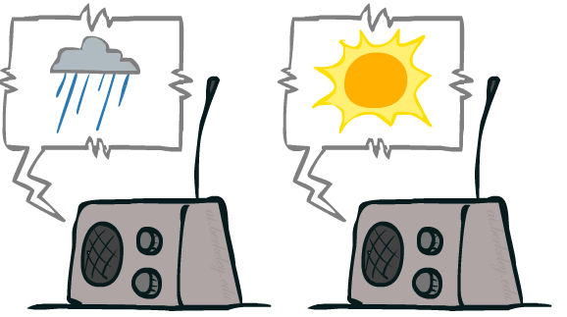
Decision Networks
Umbrella
U
Weather
Forecast
Notes:
There exists a ghostbusters demo
‹#›

Slide 4
Decision Networks
MEU: choose the action which maximizes the expected utility given the evidence
Can directly operationalize this with decision networks
Bayes nets with nodes for utility and actions
Lets us calculate the expected utility for each action
New node types:
Chance nodes (just like BNs)
Actions (rectangles, cannot have parents, act as observed evidence)
Utility node (diamond, depends on action and chance nodes)
Umbrella
U
Weather
Forecast
Notes:
There exists a ghostbusters demo
‹#›

Slide 5
Decision Networks
Action selection
Instantiate all evidence
Set action node(s) each possible way
Calculate posterior for all parents of utility node, given the evidence
Calculate expected utility for each action
Choose maximizing action
Umbrella
U
Weather
Forecast
Notes:
There exists a ghostbusters demo
‹#›

Slide 6
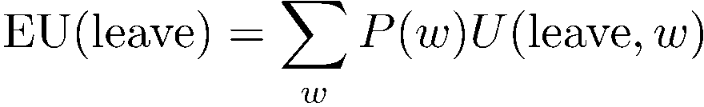
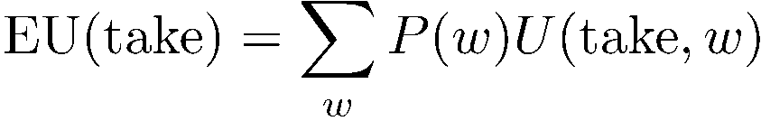

Maximum Expected Utility
Umbrella = leave
Umbrella
U
Umbrella = take
Weather
A | W | U(A,W)
leave | sun | 100
leave | rain | 0
take | sun | 20
take | rain | 70
W | P(W)
sun | 0.7
rain | 0.3
Optimal decision = leave
Notes:
There exists a ghostbusters demo
‹#›

Slide 7
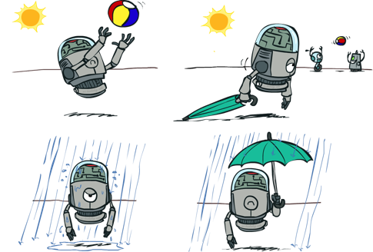

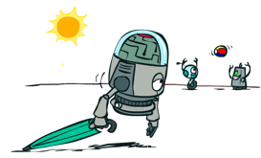


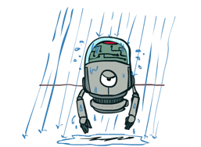
Decisions as Outcome Trees
{}
take
leave
Umbrella
Weather | {}
Weather | {}
U
sun
sun
Weather
rain
rain
U(t,s)
U(t,r)
U(l,s)
U(l,r)
Almost exactly like expectimax / MDPs

Slide 8
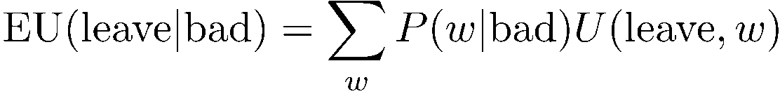


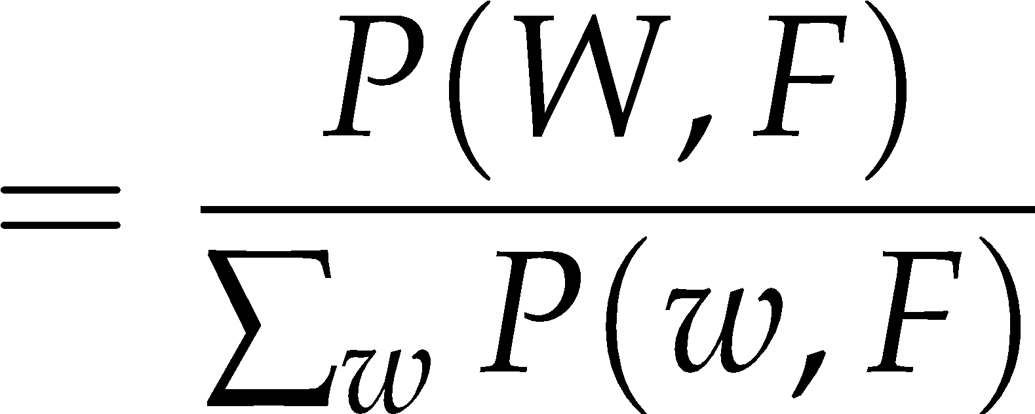
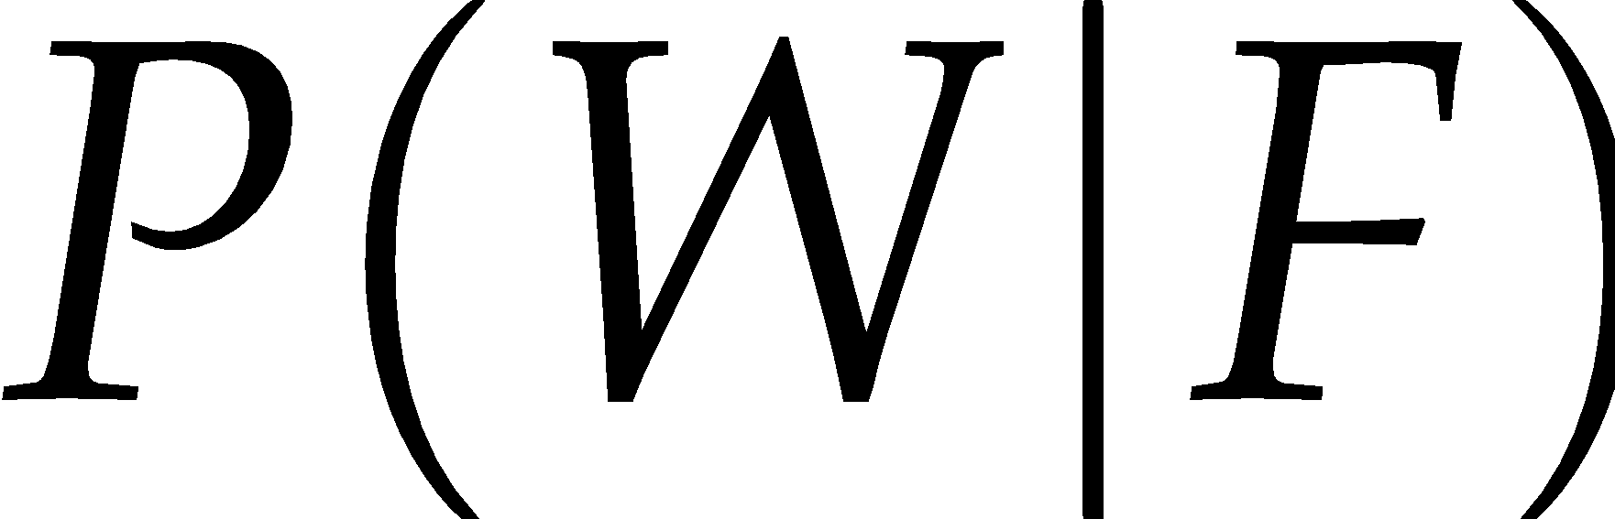

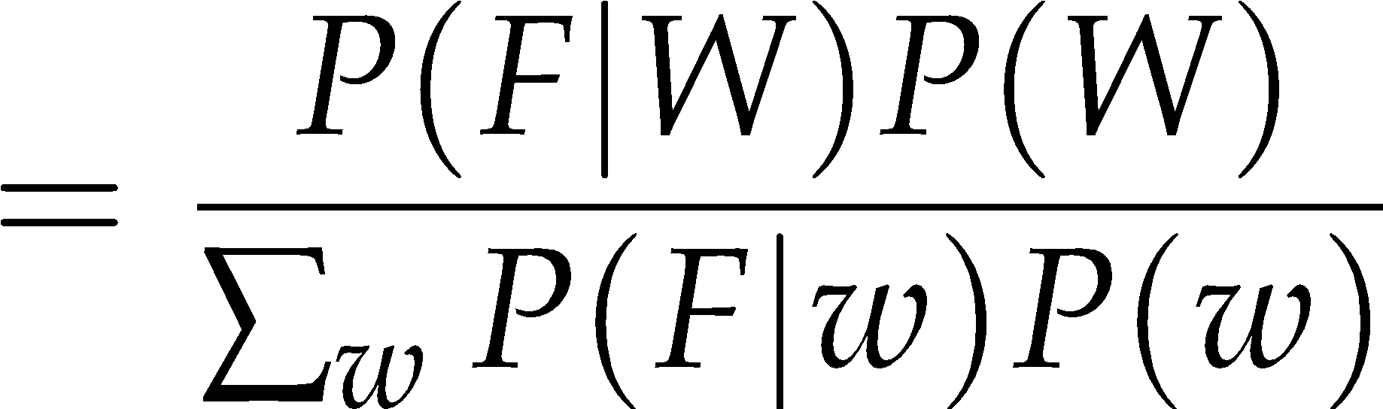
Maximum Expected Utility
Umbrella = leave
A | W | U(A,W)
leave | sun | 100
leave | rain | 0
take | sun | 20
take | rain | 70
Umbrella
U
Weather
W | P(W|F=bad)
sun | 0.34
rain | 0.66
Forecast
=bad

Slide 9

Maximum Expected Utility
Umbrella = leave
A | W | U(A,W)
leave | sun | 100
leave | rain | 0
take | sun | 20
take | rain | 70
Umbrella
U
Umbrella = take
Weather
W | P(W|F=bad)
sun | 0.34
rain | 0.66
Optimal decision = take
Forecast
=bad

Slide 10

Decisions as Outcome Trees
Umbrella
{b}
take
leave
U
W | {b}
W | {b}
Weather
sun
sun
rain
rain
U(t,s)
U(t,r)
U(l,s)
U(l,r)
Forecast
=bad

Slide 11
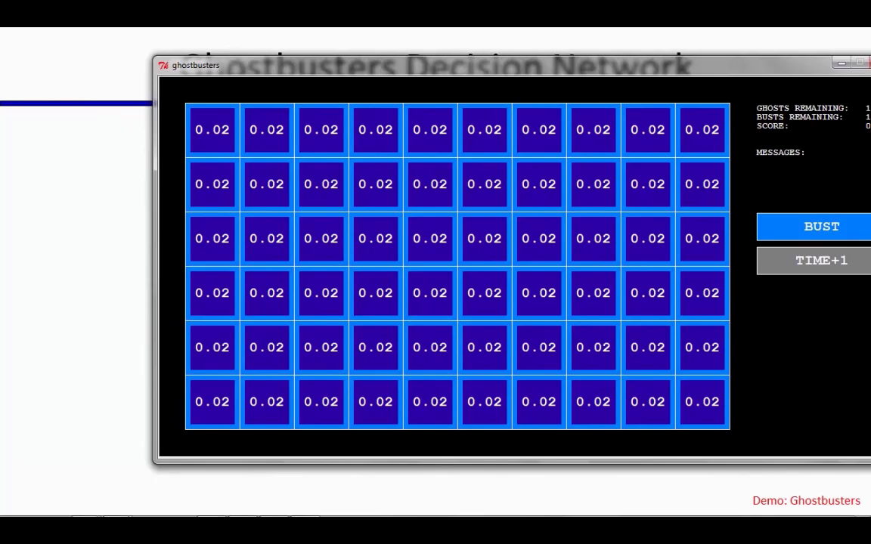
Video of Demo Ghostbusters with Probability

Slide 12
Ghostbusters Decision Network
Demo: Ghostbusters with probability
Bust
U
Ghost Location
…
Sensor (1,1)
Sensor (1,2)
Sensor (1,3)
Sensor (1,n)
Sensor (2,1)
…
…
…
Sensor (m,1)
Sensor (m,n)

Slide 13
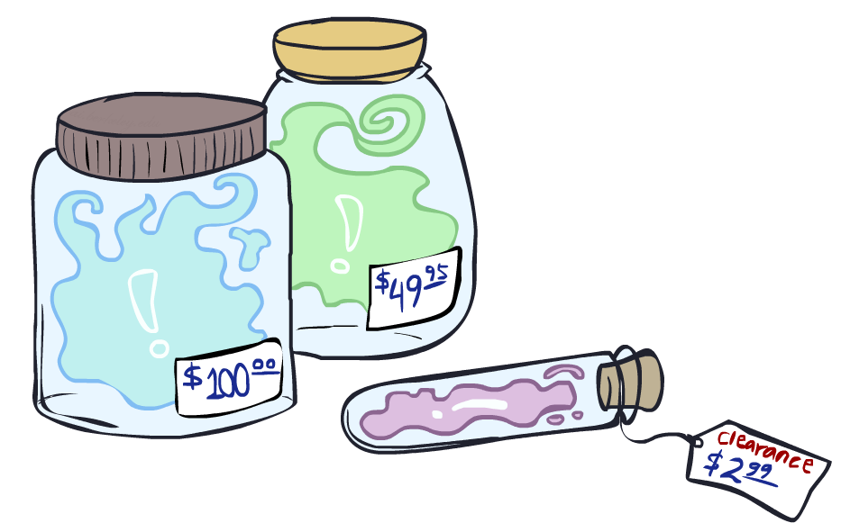
Value of Information

Slide 14
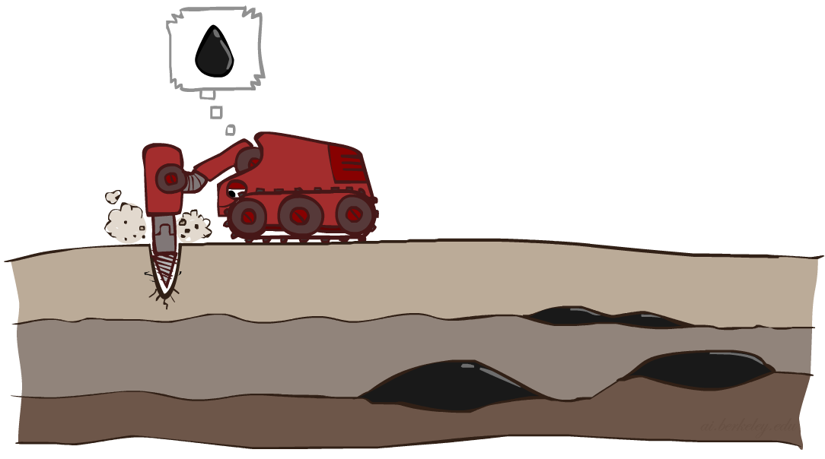
Value of Information
Idea: compute value of acquiring evidence
Can be done directly from decision network
Example: buying oil drilling rights
Two blocks A and B, exactly one has oil, worth k
You can drill in one location
Prior probabilities 0.5 each, & mutually exclusive
Drilling in either A or B has EU = k/2, MEU = k/2
Question: what’s the value of information of O?
Value of knowing which of A or B has oil
Value is expected gain in MEU from new info
Survey may say “oil in a” or “oil in b,” prob 0.5 each
If we know OilLoc, MEU is k (either way)
Gain in MEU from knowing OilLoc?
VPI(OilLoc) = k/2
Fair price of information: k/2
D | O | U
a | a | k
a | b | 0
b | a | 0
b | b | k
DrillLoc
U
O | P
a | 1/2
b | 1/2
OilLoc

Slide 15

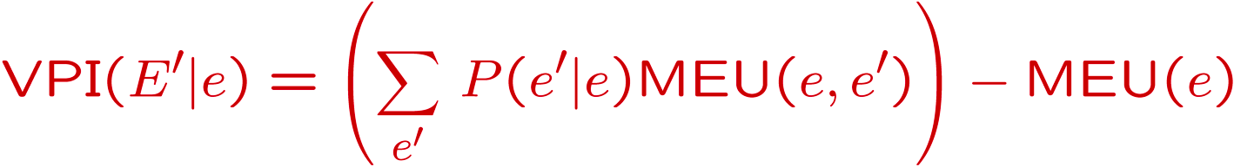
Value of Perfect Information
MEU with no evidence
Umbrella
A | W | U
leave | sun | 100
leave | rain | 0
take | sun | 20
take | rain | 70
U
MEU if forecast is bad
Weather
MEU if forecast is good
Forecast
Forecast distribution
F | P(F)
good | 0.59
bad | 0.41

Slide 16
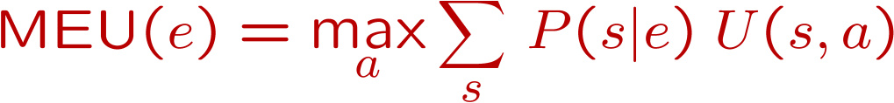
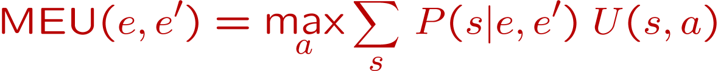
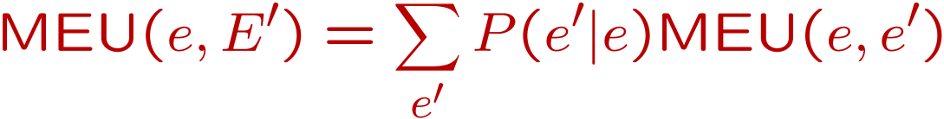
Value of Information
{+e}
Assume we have evidence E=e. Value if we act now:
Assume we see that E’ = e’. Value if we act then:
BUT E’ is a random variable whose value is
unknown, so we don’t know what e’ will be
Expected value if E’ is revealed and then we act:
Value of information: how much MEU goes up
by revealing E’ first then acting, over acting now:
a
P(s | +e)
U
{+e, +e’}
a
P(s | +e, +e’)
U
{+e}
P(+e’ | +e)
P(-e’ | +e)
{+e, +e’}
{+e, -e’}
a

Slide 17
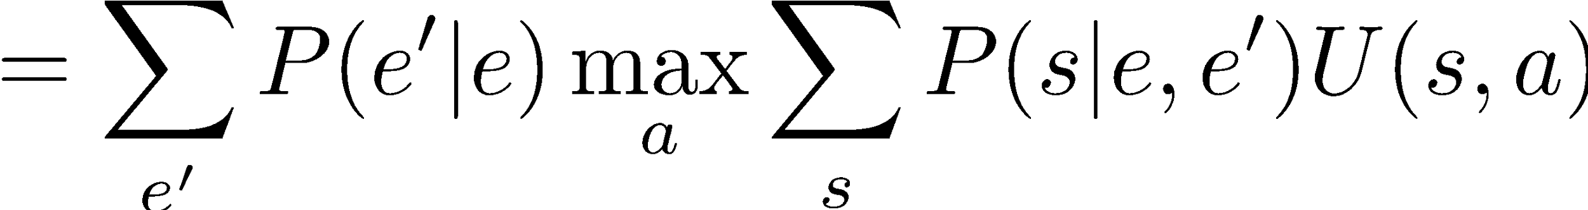
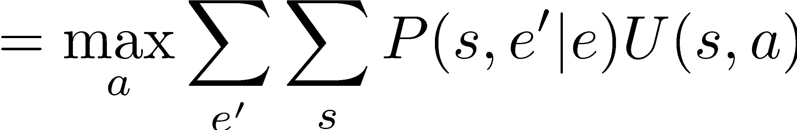
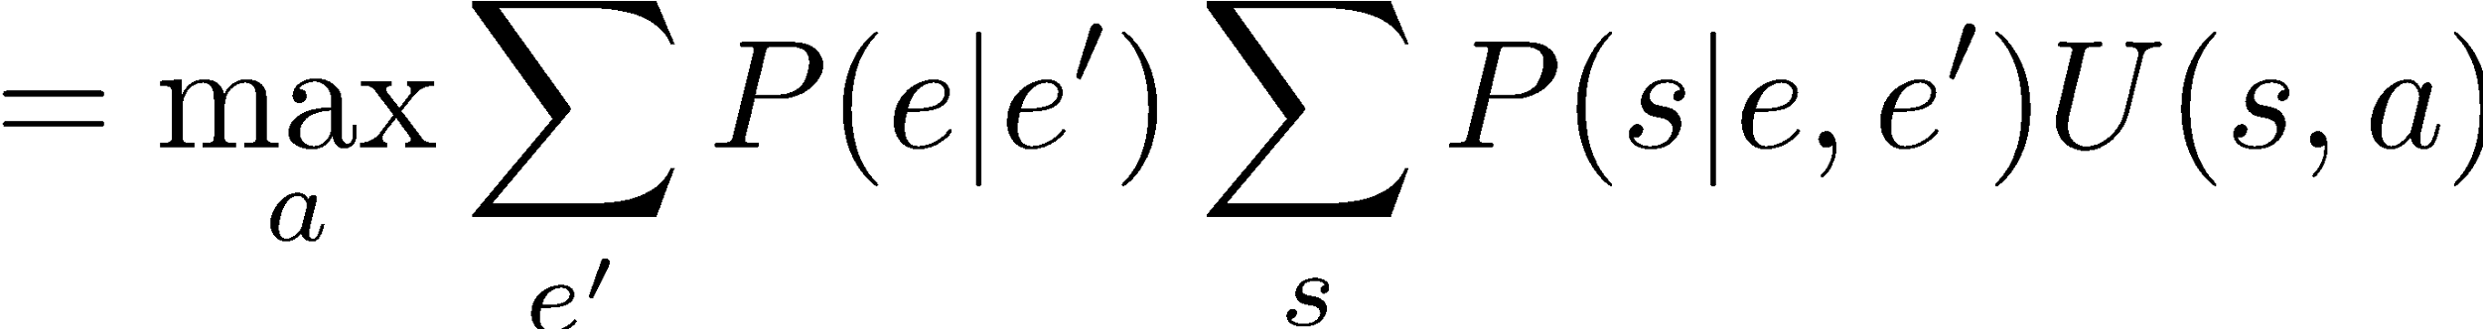
Value of Information
{+e}
a
P(s | +e)
U
{+e, +e’}
a
P(s | +e, +e’)
U
{+e}
P(+e’ | +e)
P(-e’ | +e)
{+e, +e’}
{+e, -e’}
a

Slide 18
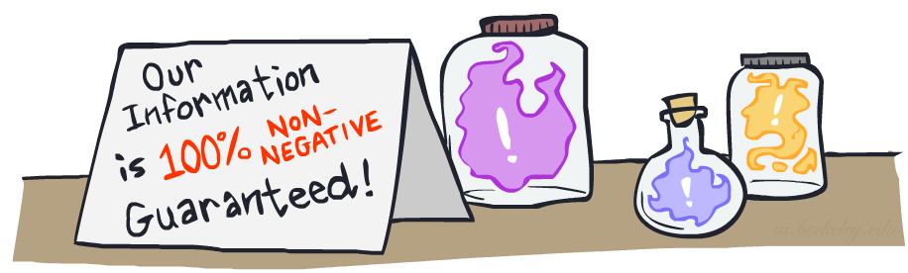


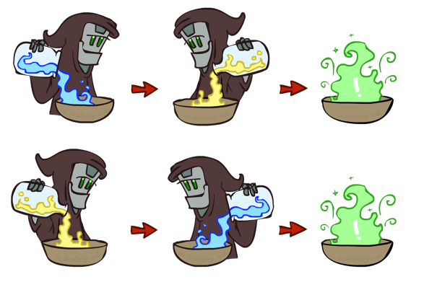
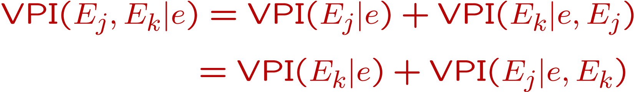
VPI Properties
Nonnegative
Nonadditive
(think of observing E_{j} twice)
Order-independent
Notes:
Usually second evidence less informative
Opposite can also happen: XOR; knowing x1 not useful, knowing x2 not useful, knowing both useful
‹#›

